Slide 1

RedIRIS
Connecting Spanish R&D&i since 1988

Slide 2


What is RedIRIS?
RedIRIS is the Spanish National Research and Education Network (NREN), that manages a powerful communications backbone in order to provide advanced connectivity services to research centers and universities. RedIRIS can deploy multiple links of up to 10.000 Mbs for academic and scientific projects.
It is a powerful data network which supports scientific development
It is a testbed for new technology and services
It is a collaborative tool for scientists
It helps to foster Information Society

Slide 3




Governance
RedIRIS is an *ICTS owned by MEIC, which defines its strategy and funds its activity
Managed by the Public Corporate Entity Red.es, under the SESIAD of the MINETAD
Operational Management
[...]
Secretary of State for Research, Development and Innovation (SEIDI)
Secretary of State for Information Society and Digital Agenda (SESIAD)
[...]
Public Corporate Entity Red.es
* Singular Scientific Technical infrastructure approved by the MEIC. These are key research infrastructures in terms of cost and relevance
CAR
Comité Asesor de RedIRIS
(RedIRIS Advisory Committee)
8 to 12 members – representatives of research and education centers

Slide 4
RedIRIS Structure
Director
Project Management
Secretariat
Dissemination and Public Relations
Connectivity and
private networks
Middleware
IT Systems and security
Digital Identity
Security
Private
networks
Mobility
Email quality
Connectivity
Storage
e-Science
NOC
Technical support to institutions
Collaboration
IT Systems

Slide 5

Goals of RedIRIS: contribution to e-Science
e-Science is the scientific activity that intensively uses new technologies. In this environment common horizontal e-infrastructures play a prominent role. This includes advanced communications networks for universities and research centres, such as RedIRIS
Astronomy
Biomedicine and Health Sciences
Materials Sciences
Natural Sciences
Physics
Engineering
Chemistry
Information Society Technology
Middleware and Applications
Communications Network
Computing resources
Storage resources
Information resources
Other resources

Slide 6
Goals of RedIRIS: Contribution to the Global Academic and Research Intranet
RedIRIS works in a multidomain environment with various research and education networks, requiring high levels of quality and coordination among them
RedIRIS directly contributes to improving global connectivity among researchers
It co-directs and co-finances GÉANT, which works with Internet2, CANARIE, SINET, RedCLARA,
Pan-European and North American networks, and more
RedIRIS
It runs the Spanish NRENs and works with other NRENs (JANET, SURFnet, FCT-FCCN, etc.)
National Research and Education Networks
(NRENs)
It collaborates with regional networks (RECETGA, Anella, RICA, I2BASK, etc.)
RedIRIS collaborates with regional and campus networks to provide high quality services to the national Scientific Community
Regional Research Networks
It offers services and support
Campus LAN

Slide 7
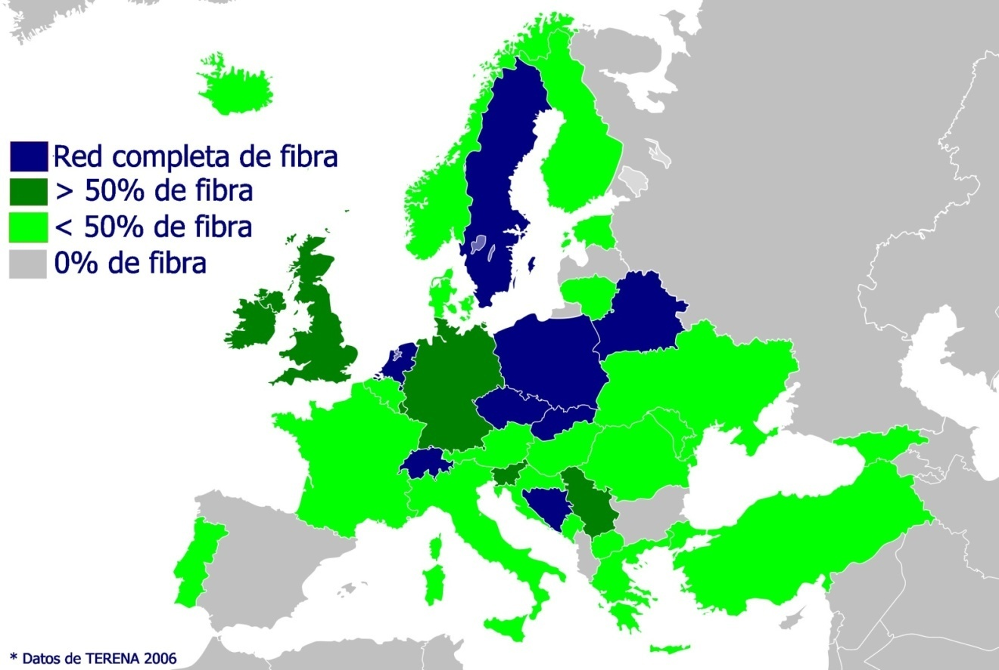

The Evolution of RedIRIS
Before 2006, most European research networks used fibre networks. Spain was behind the rest of Europe.
The solution to this problem:
The RedIRIS-NOVA Project
Obtained the right to use 14,000 km. of fibre optics for over 20 years
Total project cost: €105M (with 50M€ of ERDF funds)
Project definition
Initiates first
tenders
Implementation of the First Phase
Iberian Peninsula IRU
completed
Canary Island IRU
completed
Network operational Second Phase
Deployment completed
2006
2007
2008
2009
2010
2011
2012
2013
2014
2015
2033
2042
MICINN approval
Ministers Council approval

Slide 8
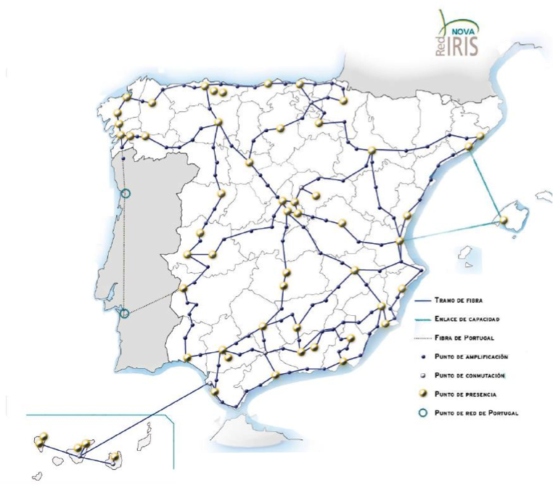
The Network
A top-level technological infrastructure in its field, which is set to provide advanced services for decades. A key tool for enabling remote collaboration among researchers and teachers, regardless of their geographic location.
Very high-capacity circuits (up to 100G)
Connects ICTSs
Supports development of
regional networks
Latest-generation dark fibre
Internet of the Future
Services
A much more powerful network
for a sensibly lower cost
Optical channels for
research projects
More efficient, robust and flexible

Slide 9
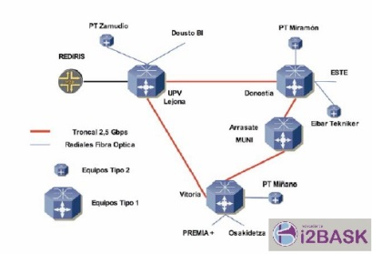
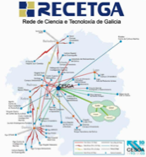
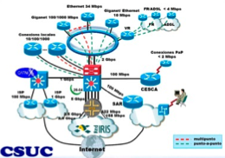
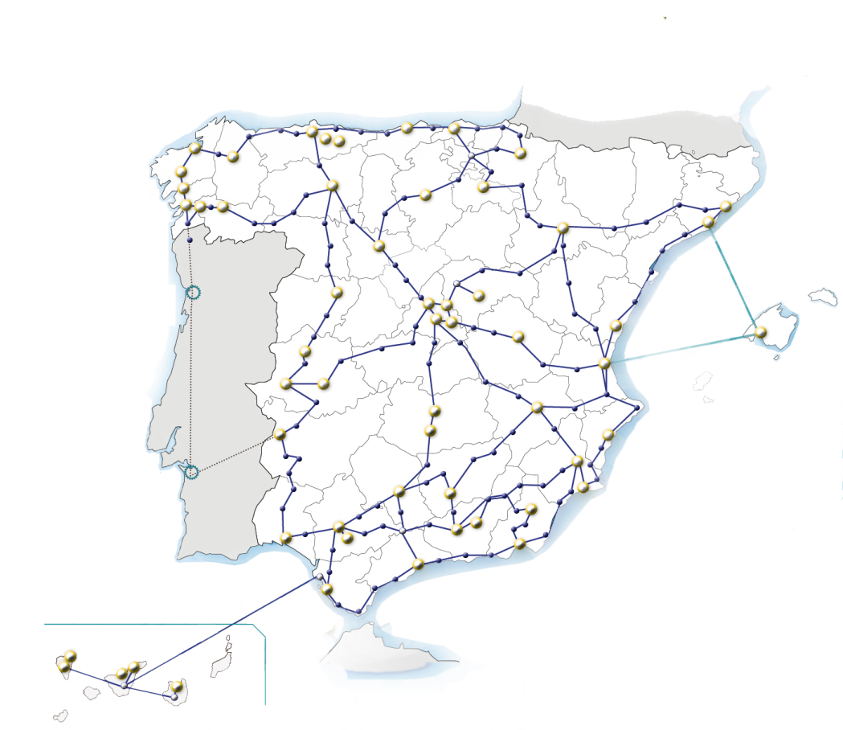
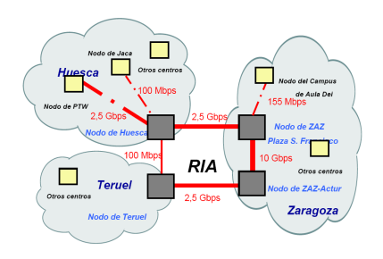
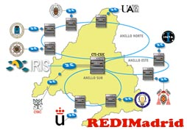
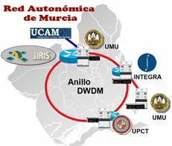

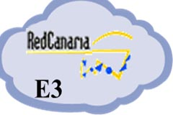
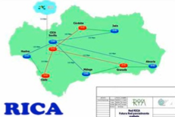

The Network
It connects universities and research institutions to each other in close collaboration with regional research and education networks.

Slide 10
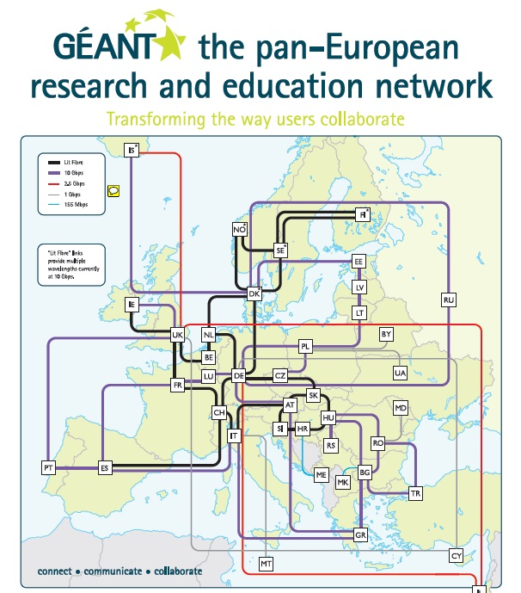
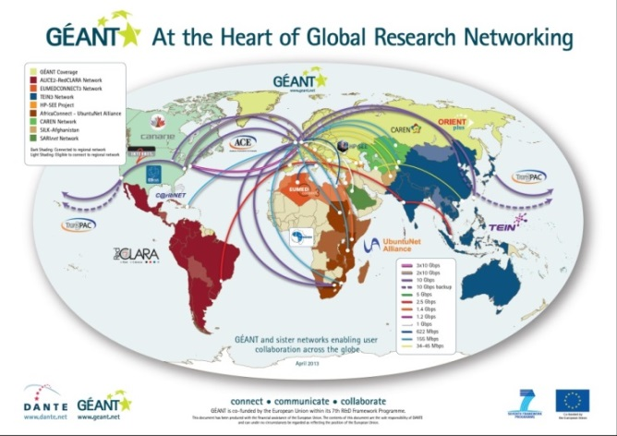
The Network
The global research Intranet
RedIRIS collaborates with other European national academic networks (NRENs) to jointly deploy and manage a pan-European academic and research network (GÉANT) which connects national academic networks to each other and to other parts of the world.
Thanks to RedIRIS and GÉANT, Spanish researchers can access academic networks in other geographical areas, such as Internet2 (USA), Canarie (Canada), RedCLARA (Latin America) or TEIN (Asia Pacific), among others.

Slide 11













The Network
It gives access to both the academic and research Intranet as well as the Global Internet through connections with global providers and its presence in neutral points of exchange of commercial Internet traffic in Spain: ESPANIX and CATNIX
Academic and research Intranet
Global Internet
√
√
2 x 10G
2 x 10G
2 x 10G
1 x 1G
IP service 3 x 10G
Projects 2 x 10G

Slide 12
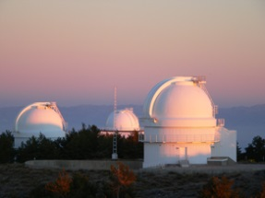
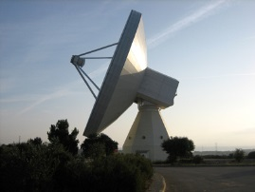
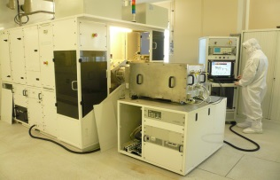

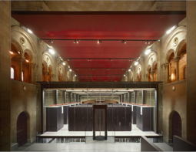
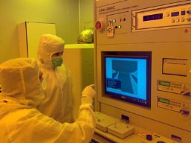


Users
RedIRIS offers its services to around 500 institutions (including Spanish universities, public research centres and ICTSs)
Others
R&D Centres
R&D Managers
17.34%
39.79%
150,000 researchers
Around 2,000,000 potential users in universities and research centers
Around 5.000.000 potential users in schools
14.89%
Dept. Hospital Research
Universities
Examples of main users:
11.63%
16.32%
Calar Alto Observatory (Almeria)
Telescope of the Yebes Astronomical Centre (Guadalajara)
CSIC National Microelectronics Centre
CERN (Switzerland)
Marenostrum, Barcelona Supercomputing Centre (Barcelona)
Laboratory of the Polytechnic University of Madrid
Doñana Biological Station
IAC Great Telescope of the Canary Islands

Slide 13
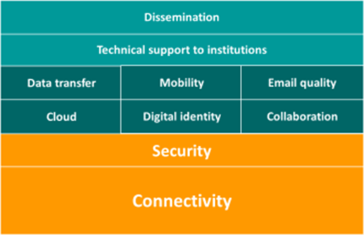
RedIRIS Services
Notes:
Promotion
Technical support to institutions
Email quality
Mobility
Collaboration
Digital Identity
Security
Connectivity
Private networks

Slide 14

RedIRIS not just a network, but a secure one:
Cybersecurity measures for RedIRIS and its users
Internet Watch Foundation
SOC
International organizations
(TI, FIRST, MAAG)
PGP Key server
Web filtering (URLs)
Mitigation of DDoS
Firewall
Digital certificates service
On demand firewall
Security incidents IRIS-CERT
Reputation lists
Training & advice
Digital identity
Mail shield
National Institute of Cybersecurity (INCIBE)
Civil Guard
Ethical hacking
Pen tests
Detection of vulnerabilities
ISO 27001
National Center of Cyber Threats
National Police

Slide 15

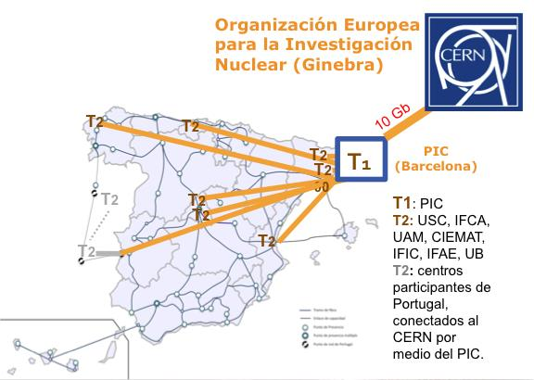
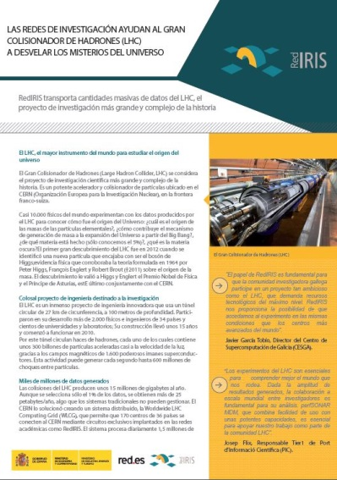

Case studies
LHC
The Large Hadron Collider (LHC) is the largest research instrument in the world and it is used, among other things, to study the origin of the universe. This innovative engineering project uses a 100-metre-deep circular tunnel with a circumference of 27 km. (located at CERN) generating billions of pieces of data which are analysed by 10,000 physicists around the world.
RedIRIS transports massive amounts of the LHC's data:
  RedIRIS connects the Tier1 Spanish centre (PIC) to the LHCOPN network using a redundant 10 Gbps circuit and offers connectivity from the seven TIER2 centres to PIC. Furthermore, it connects the Portuguese centres to the PIC

Slide 16
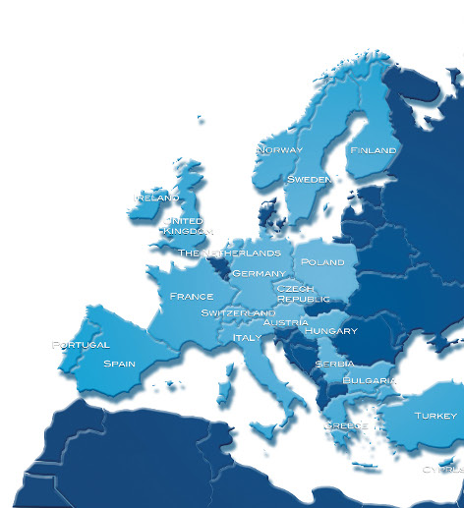
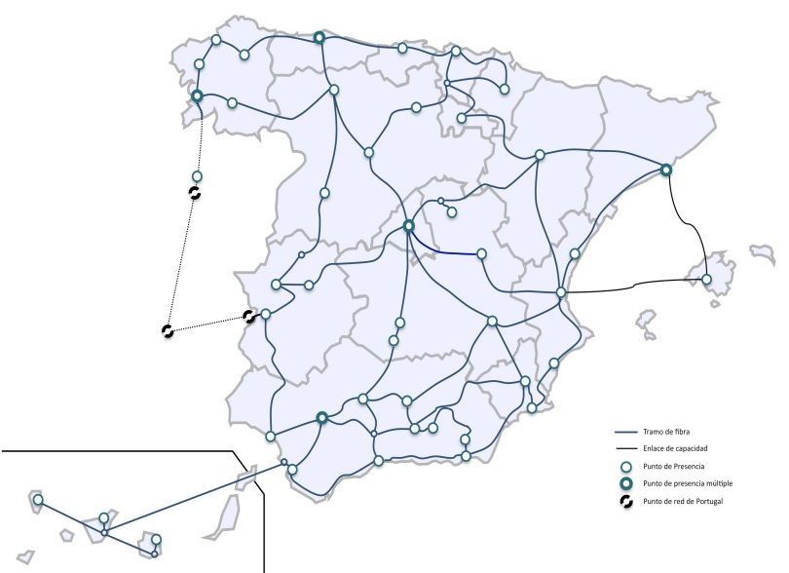



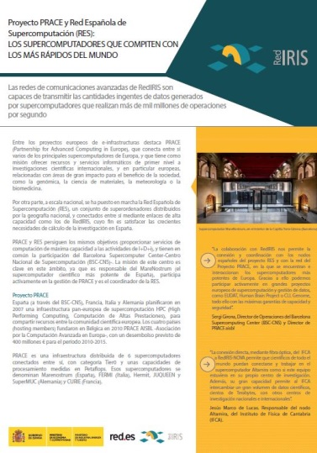


Case studies
Supercomputing
Spain has a network of interconnected supercomputers (RES), which in turn connect to the European supercomputing infrastructure through the PRACE project. Thanks to RedIRIS, which establishes the connections, enormous amounts of data are transmitted.
λ 10 Gb

Slide 17
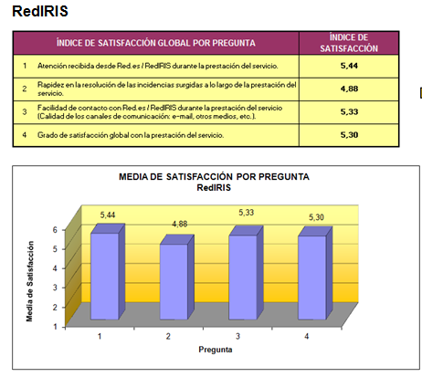


RedIRIS: User Satisfaction
2016
[ISO 9.001]
Result: 5,30 / 6
La Palma, elegida como alternativa para el mayor telescopio del mundo - EL PAÍS– 31.10.2016
“El otro gran motivo que ha facilitado la elección de La Palma ha sido la calidad de sus comunicaciones digitales, "de las mejores del mundo", según Rebolo” [Director del IAC]
2013
25 Anniversary RedIRIS

Slide 18

THANK YOU VERY MUCH!

