Slide 1
EOSC & e-Science: enabling the digital transformation of Science
Augusto Burgueño Arjona
eInfrastructures & Science Cloud, Head of Unit
EC DG CONNECT/C1

Slide 2
The role of the EOSC is to ensure that European scientists reap the full benefits of data-driven science, by offering:
“1.7 million European researchers and 70 million professionals in science and technology a virtual environment with free at the point of use, open and seamless services for storage, management, analysis and re-use of research data, across borders and scientific disciplines”
2016 Communication on the “European Cloud Initiative”

Slide 3
How? Implementation Roadmap for the EOSC
SWD adopted on 14 March
EC proposes a process to get to EOSC: implementation Roadmap along six action lines
Executes COM(2016)178 commitments, reflects WP 2018-2020 Horizon 2020 programming actions and EOSC Declaration
H2020 funding constitutes the core of the actions around wich the EOSC implementation Roadmap unfolds

Slide 4








Actions from WP 2016-2017 of the Research Infrastructure paving the way for the establishment of the EOSC
Key projects have been launched in January 2018
Pan-European access channel to EOSC services
OpenAIRE-Advance: Scholarly Communication
FREYA: Persistent Identifiers
30M€
100 partners
10M€
48 partners
5M€
12 partners
Joining other existing relevant initiatives/projects

Slide 5
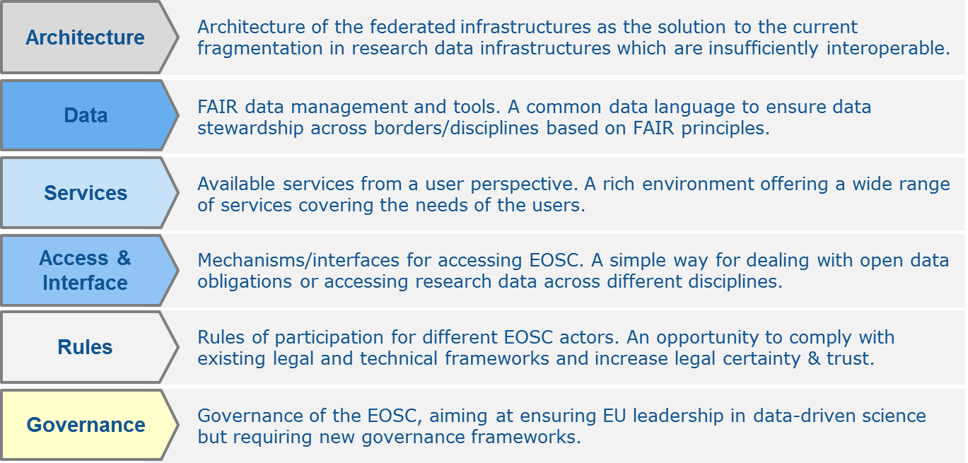
EOSC - Action lines in the implementation Roadmap

Slide 6
Architecture
  Pan-European federation of data infrastructures
The EOSC architecture comprises:
  A federating core: H2020 projects (notably the EOSC-hub) will provide an access channel with a number of horizontal services (including a portal, authentication and authorization and security access) allowing users to access the computing, data and services of pan-European and disciplinary research data infrastructures.
  A large number of research data infrastructure funded at EU, national and regional level and connecting resources and services to the core.

Slide 7
Architecture
This process of federation of resources would be implemented gradually, based on simple guidelines consistent with existing good practices:
  data infrastructures would enter the federation on a voluntary basis based on the commitment of resources and on the capacity to comply with its rules; minimum commitments would be set in the Rules of Participation;
  data infrastructures would define the extent of their own involvement in the federation, in terms of the data sets and services they would contribute to the EOSC; their commitment would be limited to these;
  data infrastructures would continue to follow their own rules outside of their specific commitments to the EOSC;
  data infrastructures would operate in the EOSC according to FAIR data principles and seek to become FAIR-accredited/certified entities;
  the structuring of the EOSC federation would occur flexibly, in response to actual needs and requests; i.e. data infrastructures that already have the capacity, commitment and added value to facilitate/coordinate EOSC operations at a geographical or thematic level could seek to become EOSC federated centres;
  the federation would entail as few constraints as needed to deliver the expected EOSC services.
  the federation process would aim to achieve economies of scale and scope

Slide 8
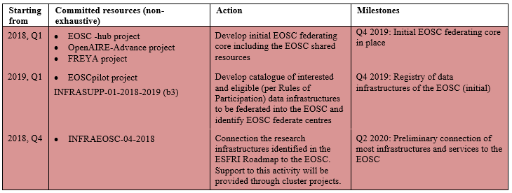
Architecture

Slide 9
  EOSC shared resources for data management covering all aspects of FAIR
Data
Identified required actions to foster the development of professional practices of research data management and stewardship in Europe:
Developing a better culture of RDM and practical skills (including actions on incentives, rewards, skills and curricula)
Developing FAIR data tools, specifications, catalogues and standards, and supply-side services
Stimulating the demand for FAIR data through consistent FAIR data mandates and incentives to open data

Slide 10
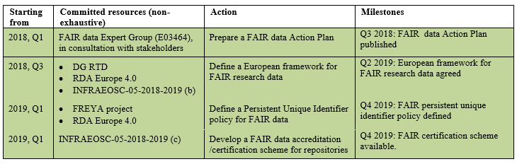
Data
And in addition:
Work on FAIR Data management and data-related skills by past and current EU funded projects
  Including coordinated strategy by EOSC-hub and OpenAIRE-Advance: competence centres, specialised training, Open Science skills, etc.
Standards and recommendations to ensure interoperability (e.g. RDA Europe 4.0)

Slide 11
  EOSC catalogue of services & datasets
Services
Unique identification and authentication service + access point and routing system towards the resources of the EOSC
Protected and personalised work environment/space
Access to relevant service information and guidelines
Services to find, access, re-use and analyse research data generated by others, accessible through appropriate catalogues of datasets and data services (e.g. analytics, fusion, mining, processing).
Services to make their own data FAIR, to store it and ensure long-term preservation

Slide 12
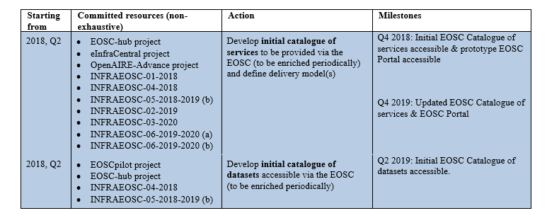
Services
Initial catalogue based on the ongoing integration and consolidation of services offered by existing service providers

Slide 13
  Setting out the rights, obligations and accountability of the different stakeholders
Rules of participation
Rules should address:
  The use of tools, specifications, catalogues and standards (EOSC shared resources) and applicable methodologies (framework for FAIR research data)
  Principles for regulating transactions in the EOSC (e.g. financial mechanisms and procedures, agreements/bylaws)
  Applicable legal frameworks (e.g. GDPR, copyright, Data Security and Cybercrime, etc.)
Based on the groundwork by EOSCpilot & EOSC High Level Expert Group & taking into account the established practices and current needs.

Slide 14
Governance
  Scope & basis of EOSC Governance
The EOSC governance should support well-defined functions…
  Strategy e.g. setting long-term orientation and priorities, deciding on compliance
  Implementation e.g. setting budgetary orientations
  Monitoring e.g. setting out KPI
  Reporting on progress
… exercised within a clear and bounded remit, including notably:
  European framework for FAIR research data
  EOSC shared resources
  Rules of Participation
  EOSC Portal
Based on the groundwork of the EOSCpilot project

Slide 15



Access & Interface
EOSC portal – Roadmap
Services under the EOSC will be made accessible via an EOSC portal, based on the work developed by current projects and further support planned in Horizon2020 for the EOSC portal.
Service providers will of course maintain their user interfaces for their own user communities
EOSC portal – Ongoing work
Collaborative effort building on current initiatives
Building an engagement channel towards the EOSC stakeholders and gateway to resources and services that support activities of the EOSC actors
Initial release: November 2018
The EOSC portal should be progressively enriched with more services and resources and new features.

