Slide 1
Ruckus Cloudpath:
Control de acceso inteligente
Juan Grau – Iberia PAM
Felix Martos – Iberia SE

Slide 2

Few Wi-Fi Devices
Nice-To-Have IT Service
Disconnects Tolerated
More & More Devices
Mission Critical
Make It Work, Always
Notes:
The explosion of Wi-Fi devices has changed how we design wireless networks. Ten years ago, Wi-Fi devices were few and far between and users were tolerant of unreliable Wi-Fi, so it was most simple to build Wi-Fi around something we already had, passwords. But, the dynamics of todays Wi-Fi networks needs a new approach; an approach that delivers interruption-free Wi-Fi over the long-term.

Slide 3
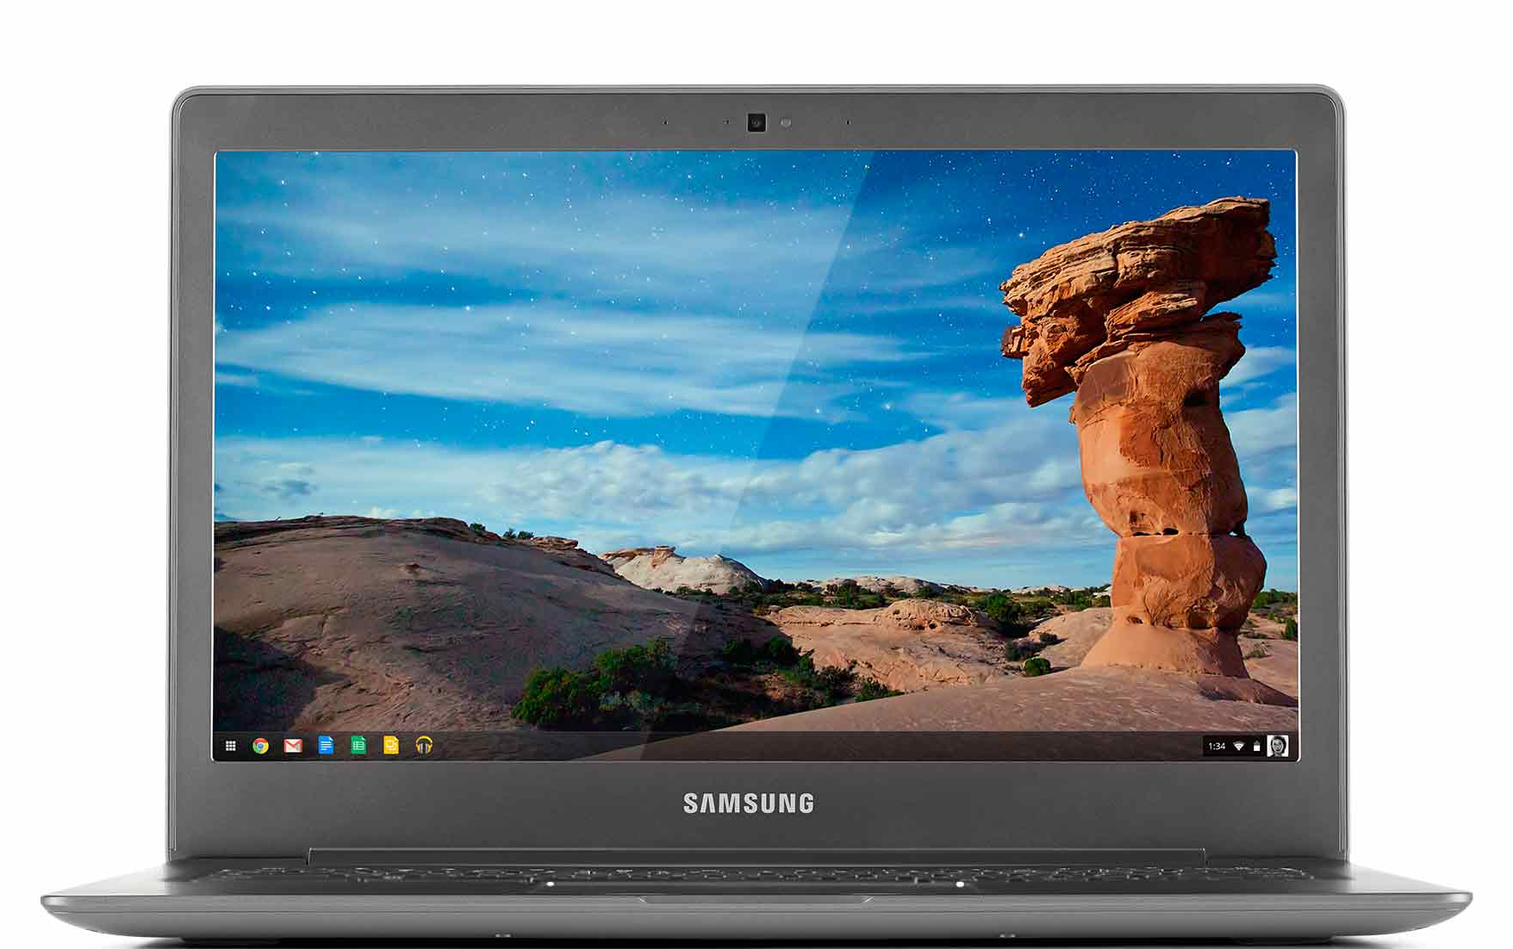
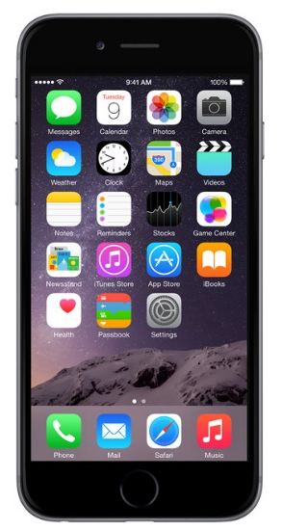

Control Your Connections
Challenges in Need of Control
stress-free security
complaint-free connectivity
hassle-free administration
Hoping your weak security is never exposed? Cloudpath will allow you to relax.
Complement your performance-optimized access with user-friendly accessibility.
Overworked? Let your network work for you with self-service features. Take a break already.
Notes:
Broad introduction to common problems within school IT.

Slide 4

Onboarding Becoming More Critical, Complex
Fundamental Shifts
Large Growth in Devices & Users
“Wi-Fi First” Approach of Connectivity
Drivers Of Growth
BYOD (All Device Types)
Managed Devices
Higher User Adoption
Chromebooks, Tablets, Phones, MAC
BYOD and Owned
More Devices
Windows Domain, IT-owned
More Users

Slide 5





Policy Management
PolicyA
PolicyB
PolicyC
PolicyD
✔
✔
✔
✔
✔
✔
✔
✔
✔
✔
✔
✔
✔
✔
✔
✔
✔
✔
✔
✔
Flexible Policy and Workflow decisions based on…
  IT-Owned vs BYOD
  Corporate vs Guest
  Device OS Type
  User authorization domain
  Certificate status
  Role Based Access
  Much more…
policyA
policyB
policyC
policyD
Student User
BYOD
Staff User
IT-Owned
Student User
IT-Owned
Staff User
BYOD
Notes:
High-level policy explanation…
Define policies centrally within Cloudpath console
Identify the decision criteria for the polciies
During onboarding, Cloudpath automatically decides and assigns the policy
WLAN infrastructure enforces traffic policy

Slide 6

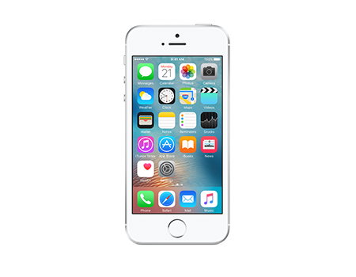




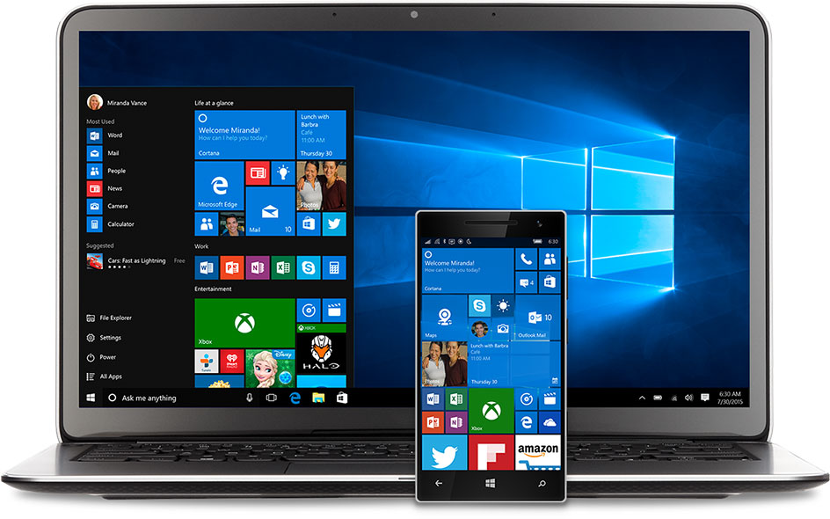
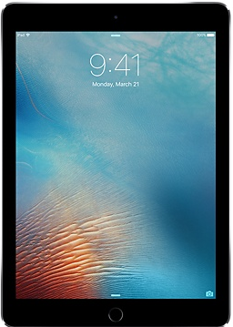

Device Enablement
Device Posturing & Remediation
Verify the device before getting it onto the network; enable Firewall, check for antivirus & windows updates install custom app and more.
Google Console Integration
Deploy The Cloudpath Extension Via The Google Console For Hands-Free Certificate Installation.
User, IT, or Distributor Provisioned
Flexibility To Allow Secure & Efficient Workflows For Various Provisioning Models. Onboard or Pre-board.
Integration with MDM vendors
Use the inbuilt light MDM or integrate with full blown MDM provider
Notes:
Cloudpath ES was the first to deliver automated certificate distribution to managed Google Chromebooks.
To distribute certificates to managed Chromebooks, a Cloudpath extension is pushed via the Google Admin Console. This extension will recognize when the device has been authorized and automatically query the certificate and install it in the Trusted Platform Module (TPM). [TPM is a hardware chip that is validated to never allow the private key to escape. This is the holy grail for certificates and is available on every Chromebook.]
Chromebooks support both “user” and “device” certificates. Cloudpath ES supports both of these. [Note: “device” is Google’s world is a bit different than in Microsoft’s world.]
Environments use different approaches to the initial setup of their Chromebooks. Cloudpath ES has the flexibility to allow for user-driven, IT-driven, and distribute-performed setup.
With Chromebooks, Cloudpath ES supports the full set of certificate sources, including built-in PKI, Microsoft CA, and InCommon. [Because most enterprise deployments of Chromebooks today are in secure environments, Microsoft CA is a more common topic than with BYOD in general.]

Slide 7

Certificate Management
1
✔
✔
2
✔
✔
✔
3
✔
✔
✔
✔
Unique
Manageable
Secure
Non-Stop
Unique certificates on each device allows policies, including VLANs, ACLs, and more, to be applied on-the-fly with certainty.
Visibility into each device, control over policies, and the ability to remove devices allows Wi-Fi to be managed easily.
Simply the gold-standard in security.
Connectivity is not disrupted by password changes, allowing Wi-Fi to finally be set-it-and-forget-it simple.
Notes:
To deliver Wi-Fi that is set-it-and-forget-it simple, Cloudpath is built around certificates. Cloudpath takes care of all the details of certificate-based Wi-Fi, but there are some benefits related to certificates that are worth pointing out.
First, they are unique per device. They are able to track a user’s five devices individually, giving policy controls and visibility over each one individually.
Second, they provide an association between the user and the device, allowing for a high degree of manageability and control over devices.
Next, they are the gold standard in security.
Finally, they are not affected by password changes, so Wi-Fi works even across password resets, which contributes to the great user experience.

Slide 8
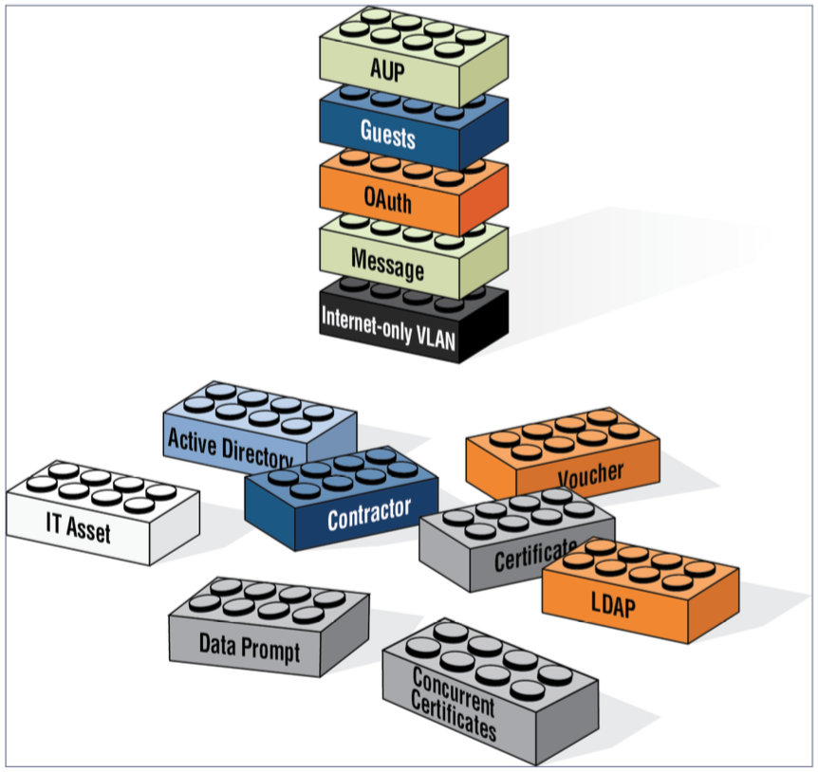
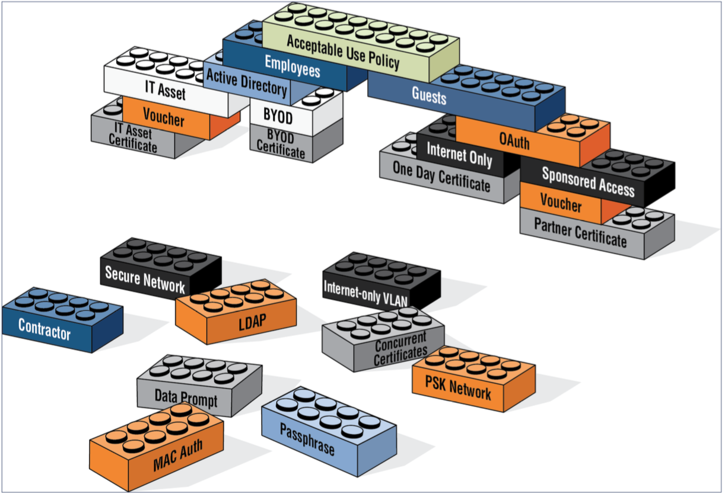
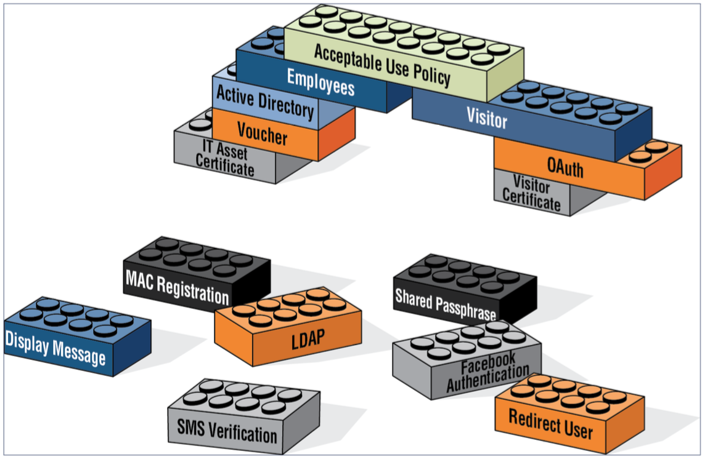
One Size Fits All
Easily buildable
workflows
Simple
Sophisticated
Complex

Slide 9
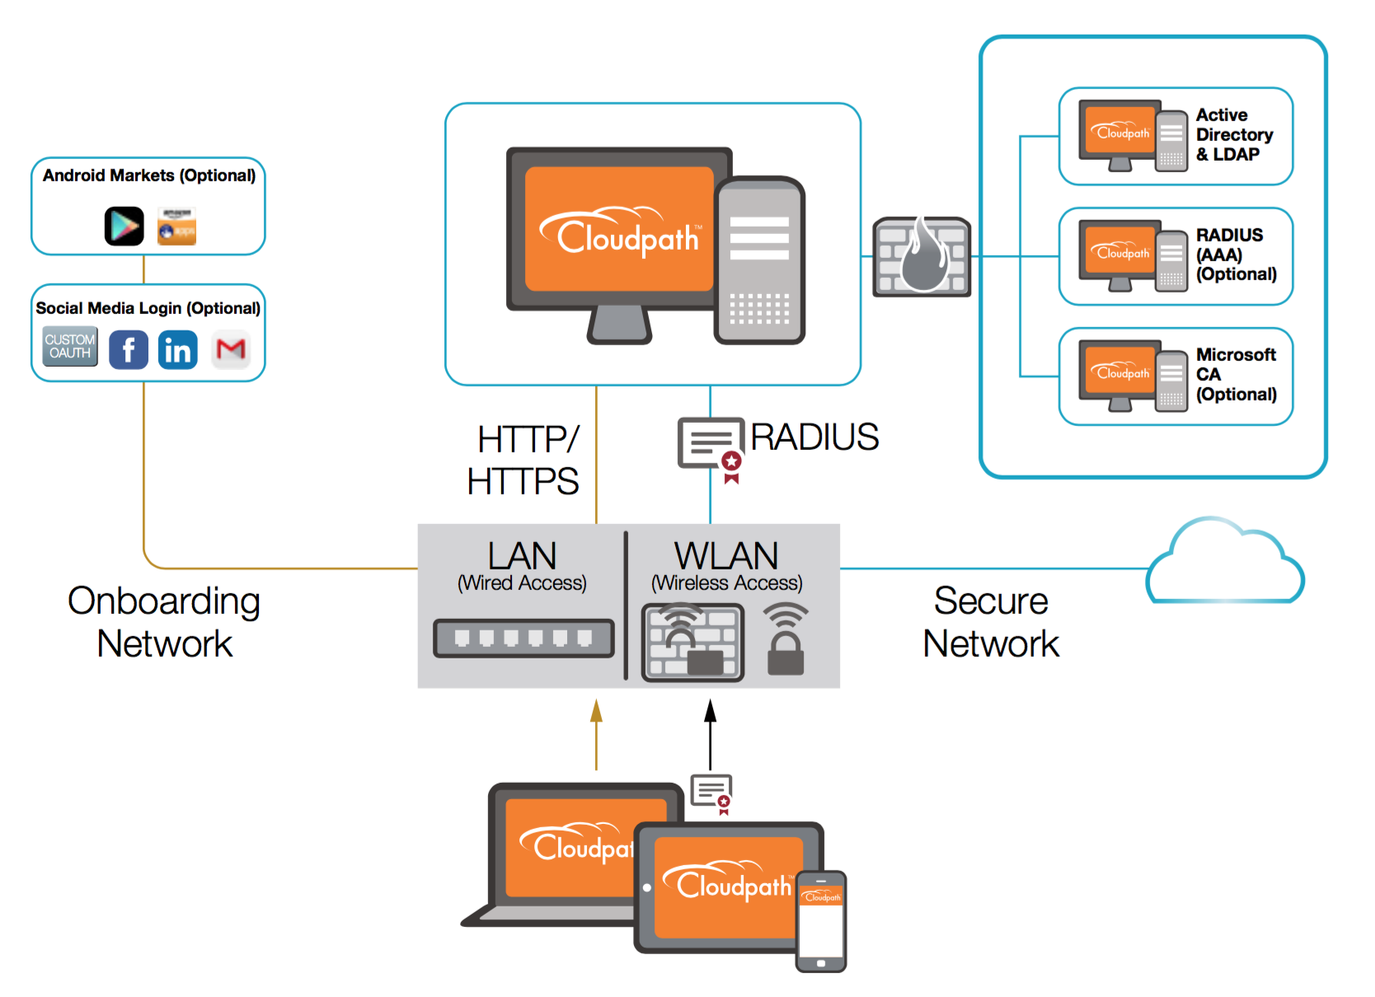
Flexible Deployment
Platform
Public Cloud
On-Premise
Identity
Inbuilt
AD, LDAP
Social Login Oauth2.0
Radius
Inbuilt
External
Certificate Authority
Inbuilt
Microsoft
Access Network
Wireless – Vendor Agnostic
Wired – Vendor Agnostic
Notes:
Cloudpath may be deployed on-site using Vmware or in the cloud. Either way, the functionality of the system is the same.
New devices typically enter through an open SSID, which redirects the user to Cloudpath.
Cloudpath with authenticate and authorize the user and then configure the device with the certificate and secure SSID. On all devices except iOS, Cloudpath will then move the device to the secure SSID. The device will authenticate using the certificate and Cloudpath will process the RADIUS authentication.
Devices may also enroll over the web; allowing students to activate their device during the summer so it just works on back-to-school day.

Slide 10
Full-Service Platform Integration
Integrated Platforms
Ruckus Cloudpath
RADIUS – efficient and flexible 802.1X connectivity
PKI – certificate management has never been this easy
Client Provisioning – support for all client OS types
User DB Integration – integrate with existing user databases/CAs
Device Management – enforce device-specific settings for antivirus, firewall, passcodes, NAC, proxies
Guest Access – secure or traditional self-service guest
Policy Engine – enforce custom user and device privileges
RADIUS
PKI
Device Provisioning
User Database Integration
Device Management
Guest Access Services
Policy Engine
Notes:
This slide is intended to explain in more detail what the Cloudpath solution is—what it does and what features it provides.
ES is a platform that simplifies the deployment of several services that are typically disparate and complex to manage. In building ES, Cloudpath’s focus was to take systems that are typically very complex and intimidating to implement and make it easy—making the best security more accessible to lean IT teams.

Slide 11

APIs Allow 3rd Party Integration
Firewall
Antivirus
Switch
MDM
IoT
Wireless Network
Notes:
Cloudpath may be deployed on-site using Vmware or in the cloud. Either way, the functionality of the system is the same.
New devices typically enter through an open SSID, which redirects the user to Cloudpath.
Cloudpath with authenticate and authorize the user and then configure the device with the certificate and secure SSID. On all devices except iOS, Cloudpath will then move the device to the secure SSID. The device will authenticate using the certificate and Cloudpath will process the RADIUS authentication.
Devices may also enroll over the web; allowing students to activate their device during the summer so it just works on back-to-school day.

Slide 12




Solution Partners
Firewall
Cloudpath sends user identity to Palo Alto, enabling granular traffic policing
Roaming
Network
Cloudpath secures devices using 802.1X, making them eduroam-ready
Chromebook
Streamline Chromebook authentication
MDM
Filter IT-owned vs BYOD with appropriate policies; Single CA for all devices
Content Filter
Enable the CF to filter encrypted/https content
Notes:
ebook

Slide 13







Broad Client support
10.7 & higher
4.3 & higher
XP & higher
6 & higher
12.04 & higher
18 & higher

Slide 14




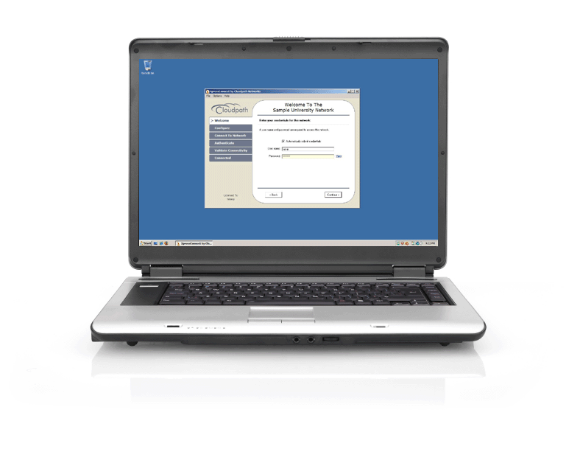
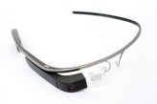


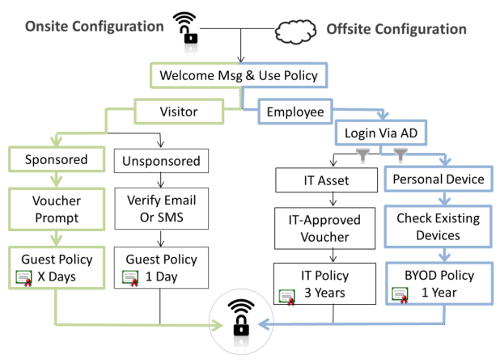


Self-Service Onboarding
Day 1
Day 2+
BYOD Devices
Self-Service Onboarding Portal For All Users, All Devices
Wi-Fi “Just Works”
Employees
Students/Faculty
Contractors
Partners/Vendors
Guests
Automatically Connects
No Splash Page
Fully Authenticated
Policies Via VLANs, ACLs, etc
Fully Encrypted Session
IT Devices
Managed Chromebooks
IT-Owned MacBooks
IT-Owned Mobile Devices
Scanners
Printers
Notes:
At the heart of Cloudpath is the onboarding portal, which allows administrators to define policies in a highly flexible yet easy to understand manner.
Users access the onboarding portal to enroll new devices when they enter the environment for the first time.
This one-time activation process may be performed onsite via an onboarding SSID or over the web.
During activation, the user will go through the administrator-specified workflow to get authenticated, authorized, and ultimately configured and moved to the encrypted SSID.

Slide 15
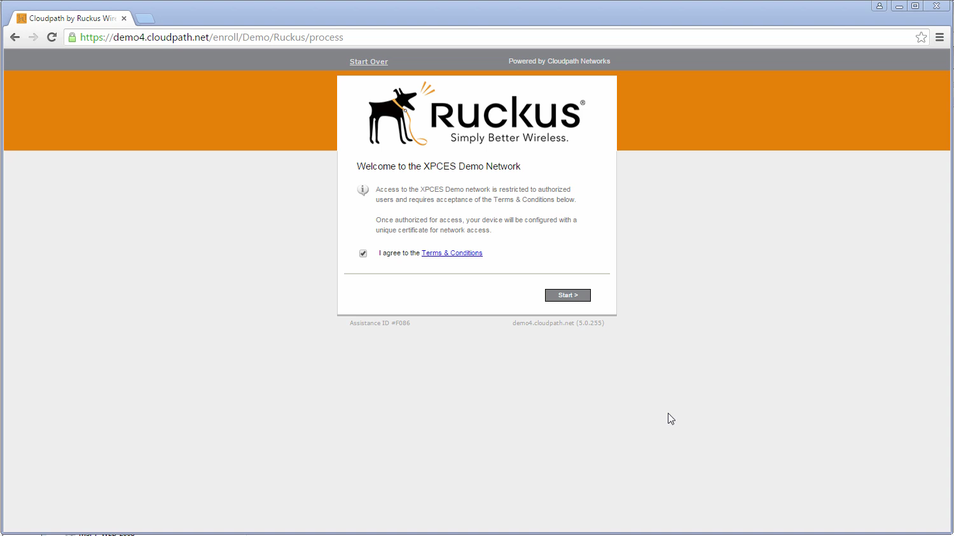
End-User Experience
Day 1 Experience
Notes:
This is an example of the day 1 user experience on Windows. We have it configured to present the user with an acceptable use policy and prompt them to select between student or guest. As a student, they are required to login via active directory. Then, they can review their existing devices and clean up any that need to be.
(As the download occurs)
At this point, the user is authenticated and authorized to be put on the encrypted SSID as a student with the BYOD policy. The wizard will kick in to configure their device with the certificate and SSID, and then move them to the secure SSID and turn them loose.

Slide 16
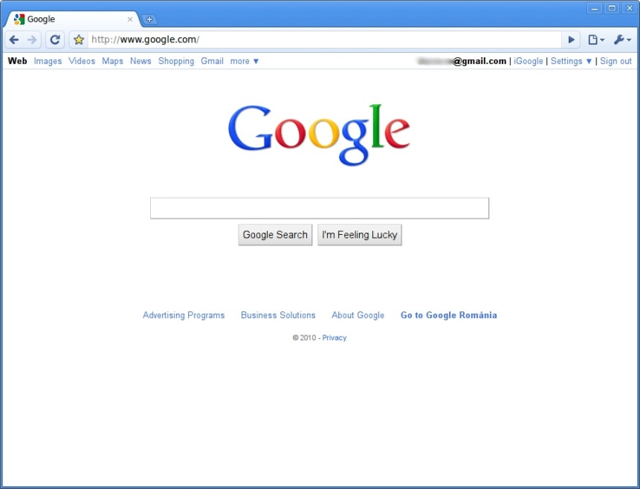
Day 2 Experience
Wi-Fi “Just Works”
Automatically Connects
No Splash Page
Fully Authenticated via Certificate
Policies Applied Dynamically using WPA2-Enterprise
Fully Encrypted Session

Slide 17

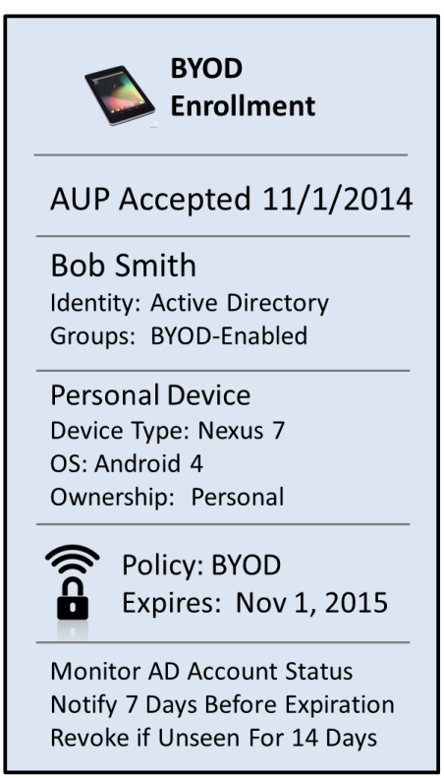
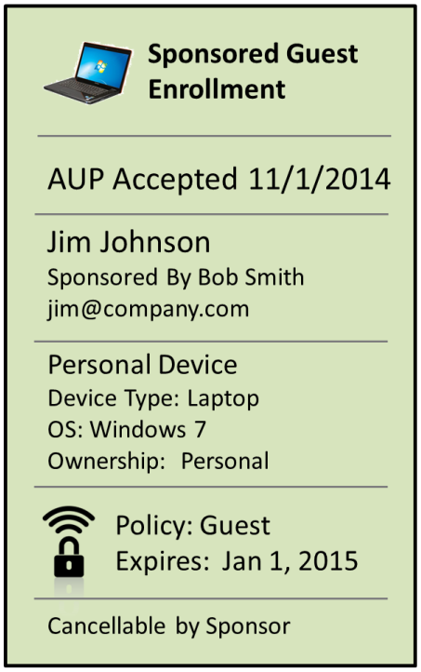
Self-Service Onboarding
Notes:
The onboarding portal is built around an administrator-specified workflow. The workflow is completely ad-hoc and built from 15 different types of building blocks. In our enrollment a moment ago, we followed the blue path. We were presented with the AUP, we selected employee, we logged in and was ultimately granted the BYOD policy.
Along the way, the system captured and stores the information about the user, device, certificate, and policy.

Slide 18


Integration with Wired
Features and Capabilities:
802.1X authentication
MAC authentication
External Web authentication
Flexible Authentication sequence (802.1X,MACauth)
Remediation for non compliant devices
CoA (ACL, disconnect, flip port, disable port, re-auth)
Internet
User/Device based Dynamic VLAN,ACL
3
2
4
4
Flexible Authentication 802.1X & MACauth
Guest VLAN
Intranet
1

Slide 19
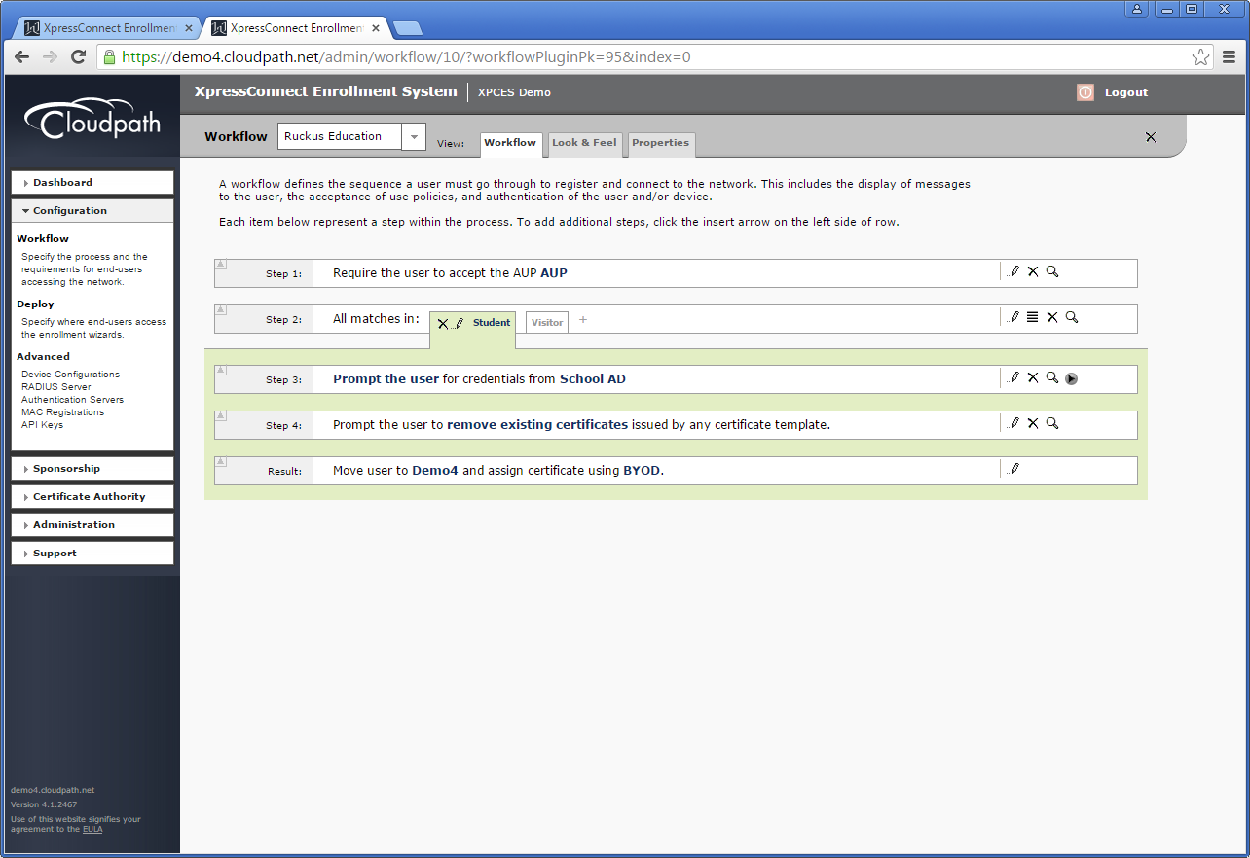
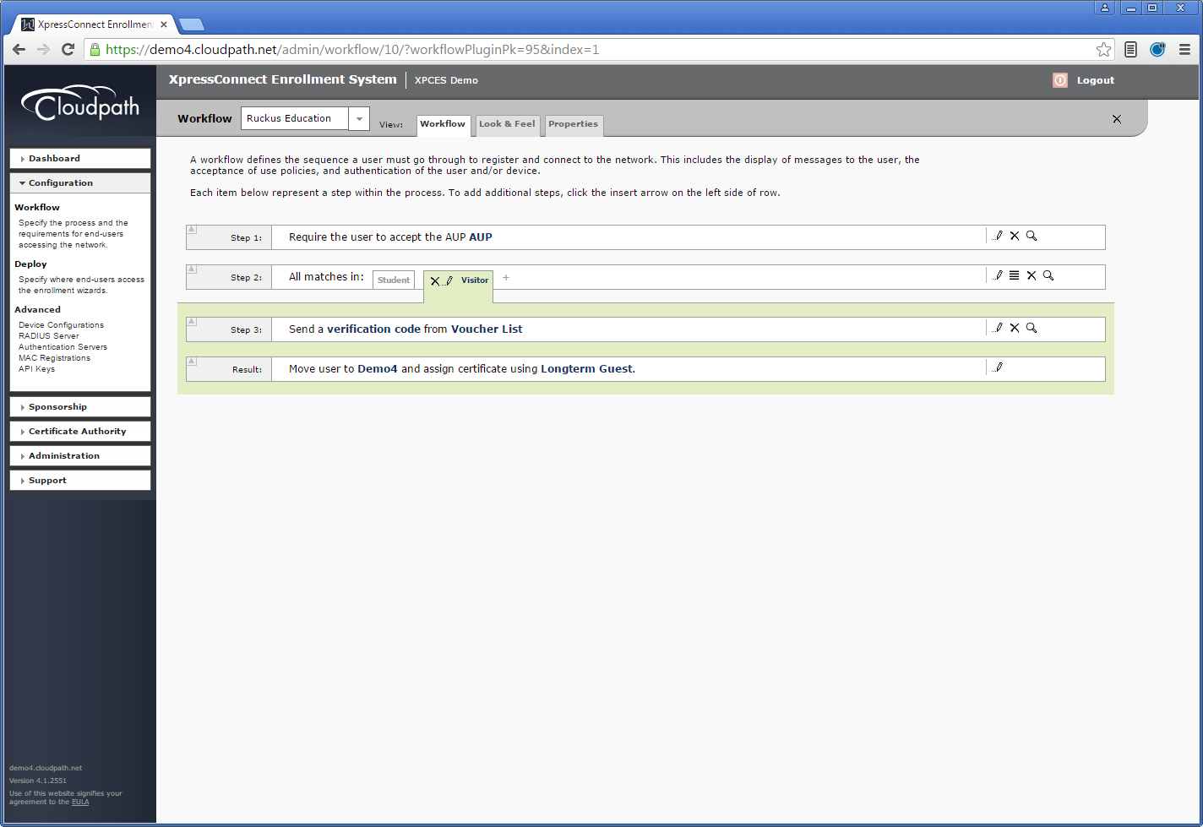
Administrator UI
Notes:
In the administrator UI, the definition of the workflow occurs in a very easy-to-understand manner. For many customers, this workflow becomes a self-documenting system of what the policies on the network are, what is required to be granted one of the policies, and historically who’s qualified and been granted which policies.

Slide 20
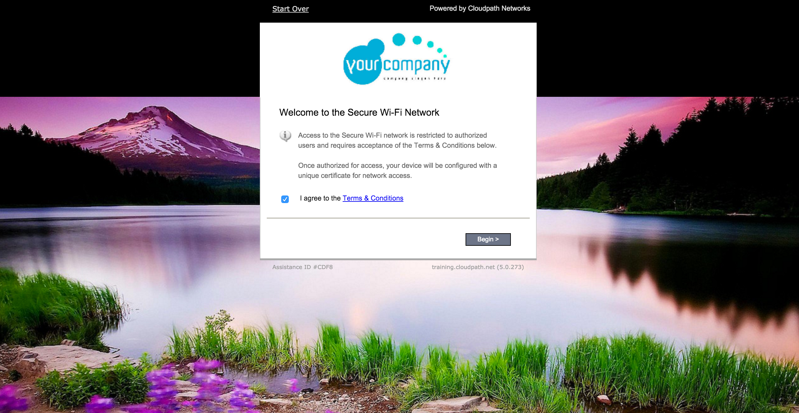
Graphic banner can be added here
Bar colour
T&C text customised
Button text and colours
Any background can be added. This example has a full screen image

Slide 21




Cloudpath At A Glance
Automated Onboarding
Securely Simple
Self-Service Portal Automatically Provisions Devices For Network.
Zero-To-Gold Standard
Security In Minutes For Administrators And Users.
Certificate Infrastructure
Rich Policy Control
Policy-Enabled Certificates Tie User, Device, and Policy Together Without Passwords.
VLANs, ACLs, & Policies Based On User, Groups, Device & More Give Per-Device Control.
RADIUS
Cloudpath
Broad Device Support
Applies Policies To Certificate & MAC Authentications Without Traditional RADIUS Complexities.
Plug & Play Solution
For Delivering
Certificate-Based Wi-Fi
To BYOD, Guest, And
IT Devices.
iOS, Android, ChromeOS,
Mac OS X, Windows, Linux & More.
Device Visibility
Wi-Fi Reliability
Tracks Who, What, & Why
Of Every Device On Your Network.
Eliminates Password-Related Disconnects, Support Costs, and Security Problems.
Ruckus Proprietary and Confidential
Notes:
Cloudpath allows a network to move from zero to the gold standard in security easily, both for the administrator and the users.
The ability to track each device uniquely based on the certificate allows rich policies, including VLANs and ACLs, to be applied on a per-device basis.
The onboarding portal supports automated configuration of most BYOD-style devices, ensuring users can connect quickly to the secure SSID.
And, since the Wi-Fi is free of password-related disconnects, users experience uninterrupted Wi-Fi and generate fewer support tickets.

Slide 22
Comparing with Others
Others
No cloud offering
No native Google Console support
No multi-tenancy: not for MSPs
Separate charge-for modules
Partially WLAN-vendor agnostic
Moderately to highly complex UI
Device-based licensing
Requires bespoke PS engagement
Cloudpath
Cloud everything
Easiest Chromebook onboarding in the business
MSP-ready multi-tenancy
One all-inclusive price
WLAN-vendor agnostic
Simple workflows
User-based licensing
Out-of-the-box or “white glove”

Slide 23


Thank you!
GRACIAS
www.ruckuswireless.com
facebook.com/ruckuswireless
@ruckuswireless

