Slide 1


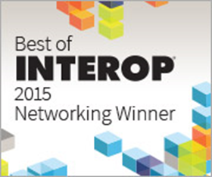
Intelligent Fabric (iFab)
The Next Generation Network Infrastructure
Jorge Arasanz, jorge.arasanz@alcatel-lucent.com May, 2015
Notes:
NOTE: This is the correct photo to use for ALU-Enterprise in 2015. Do not use for other verticals.

Slide 2
Campus Networks
Access
Access
Access
Core/Transport
Datacenter
Datacenter
Access
Access

Slide 3
Unified Access & Application Analytics

Slide 4
The Next Generation Network Infrastructure
Traditional Corporate Networks without Unified Access
Corporate user directory secures application access only
LAN is open to abuse
Weak WLAN access security
Large investment operating two networks with independent management systems
Inconsistent user experience between LAN and WLAN
Poor or no QoS offered
LAN NMS
WLAN NMS
LAN
WLAN
Open Access
Weak Access

Slide 5
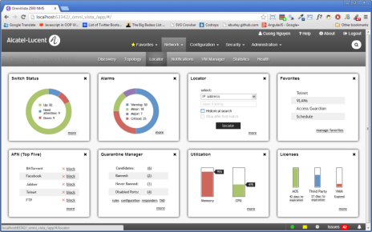
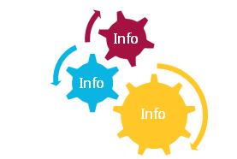
The Next Generation Network Infrastructure
Analytics - Directions
    Networks needs are changing
    BYOD Trend
    New applications and data patterns
    Bottlenecks for corporate APPs
    Network Planning is required
    Application Visibility for QoS
    Troubleshooting Tools
    Historical and predictive views
Business Decision
Real-time information to enable real-time business decisions

Slide 6
The Next Generation Network Infrastructure
Alcatel-Lucent Enterprise Unified Access Network
UNIFIED NMS
Corporate user directory secures application and network access
Secure LAN & WLAN access (based on roles)
Reduced IT effort operating one integrated network with one management system
Consistent user experience between LAN and WLAN
Unified Role based QoS
UNIFIED NETWORK
  BETTER USER EXPERIENCE
Role Based Protected Access
  SIMPLIFIED OPERATIONS
  IMPROVED NETWORK SECURITY

Slide 7
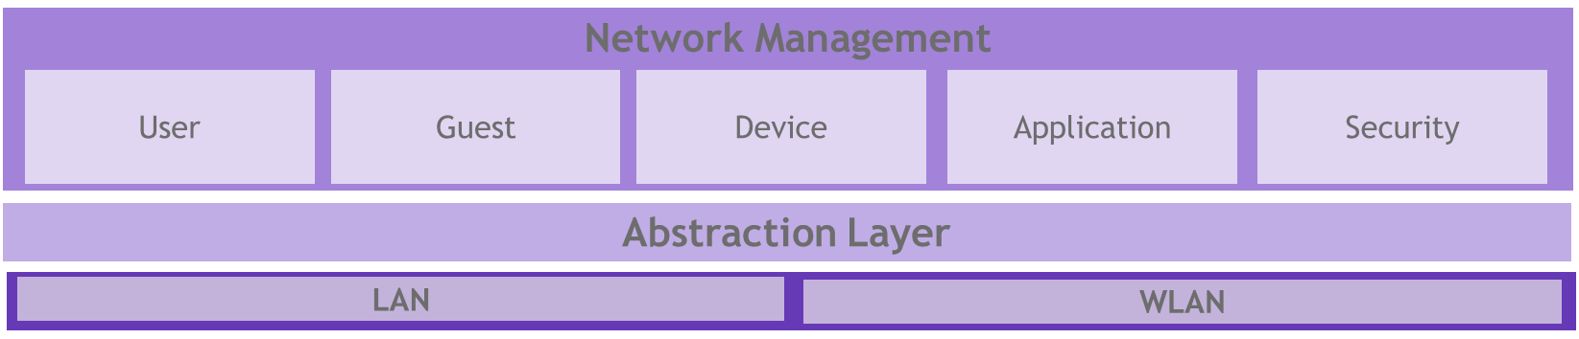

The Next Generation Network Infrastructure
Unified Access – Simplifying operations
OmniVista 2500 NG
UNIFIED ACCESS NETWORK
ClearPass
Reducing costs
One centralized console simplify operations.
IAP
OmniSwitch
WLAN Controller

Slide 8















The Next Generation Network Infrastructure
Application Analytics – Legacy vs Next Generation Infrastructure
Without Analytics
TCP443
Business critical apps
TCP80
UDP53
UDP53
TCP80
Other business apps + personal apps
TCP443
XXX
Non-compliant apps
With Analytics
Business critical apps
Other business apps + personal apps
Non-compliant apps

Slide 9
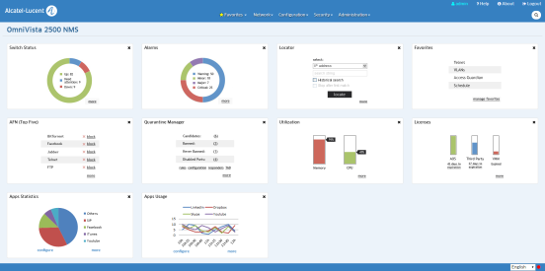
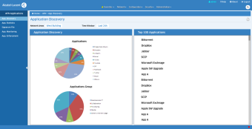
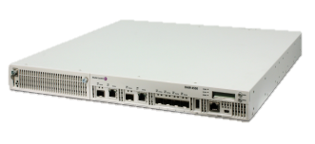
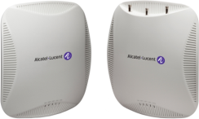
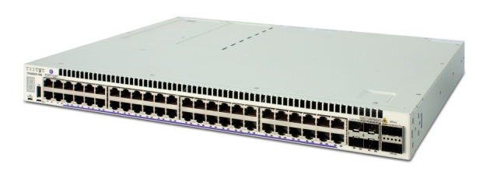
The Next Generation Network Infrastructure
Unified Application Visibility && Control – Wired && Wireless
Unified view of wired and wireless network
        Same signature set
        Same application groups
        Aggregation of statistics
Unified Policy Configuration
        Role and Profile Definition
        Consistency of Profiles and Enforcement rules
Application Visibility and Enforcement enabled by OmniVista License (time based)
        OmniVista feature
        Signature subscription
        Switch full signature support
Signature updates
Wireless App/User statistics
Policies
Policies
Wired App/User statistics
Signature updates

Slide 10

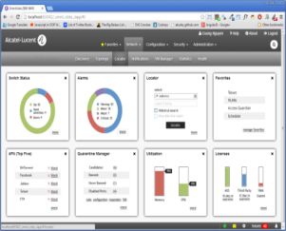








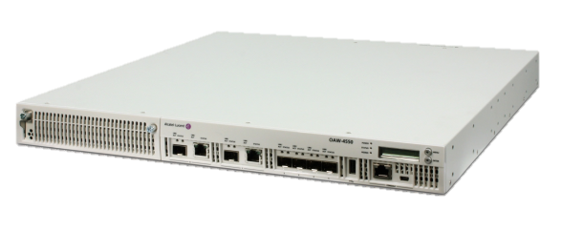
The Next Generation Network Infrastructure
Application Analytics – Key Elements
OV2500
Application Visibility
        Per application, per user statistics collection
        Network usage statistics per application/user
        Monitoring and reporting of statistics
Application Control
        Per application priority and QoS marking
        Per application rate limiting
        Per application blocking
        Centralized policy management
Ease of Signature Management
        Automated signature download
        Customizable signatures
✓
✓
OS6860/E
OAW4X50/IAPs

Slide 11
Intelligent Fabric
For Converged Campus Core and Datacenter

Slide 12

Intelligent Fabric evolving a NEW NETWORK HORIZON
EASY button…
Network Design
Bandwidth
Access
Redundancy
Maintain
Self-healing
Move Add Changes (MAC)
ISSU
Network Deployment
Value Added Services
Unbox
Connect
Power on
Application Integration
Network Reporting
Customer centric solutions
Notes:
Value Add Services:
-Application Integration: OpenFlow and OpenStack support across entire portfolio.
-Network Reporting: VM Snooping provides complete visibility for the VM to VM traffic using legacy or newer technologies like VxLAN
-

Slide 13
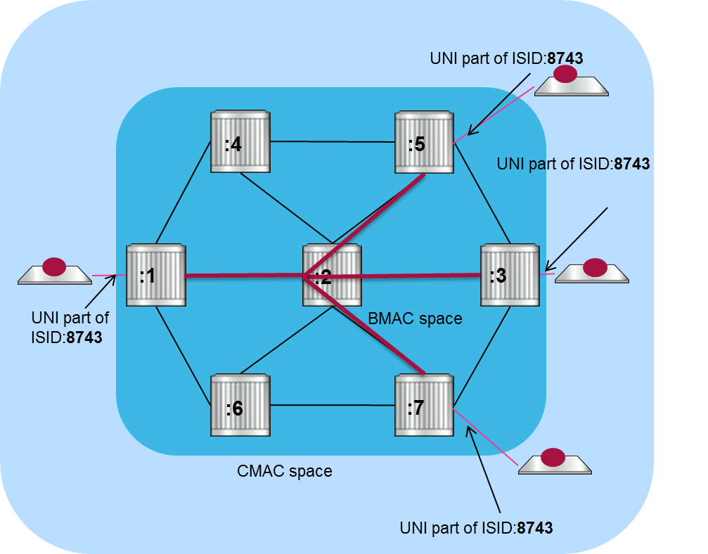
FABRIC – Flexible Organic growth, STANDARD based
SPB - Shortest Path Bridging (IEEE 802.1aq)
+
VXLAN (RFC 7348)
Proprietary or traditional protocols do not scale
No Loops. Improved BUM traffic Management
All links ACTIVE - Load Balancing.
Scale UP, DOWN, LEFT, RIGTH… as you NEED, EASY !!!
Multi-Tenant, Services scalability
SPB provides AutoService Provisioning

Slide 14



ADVANTAGES OF INTELLIGENT FABRIC
HIGH AVAILABILITY
VC
99,999%
No SERVICE IMPACT:
Signaling Networks (High Speed Trains)
Communication Services
Resiliency for multiple failures
VC
VC
SPB
OPEN
Based on 802.3ad, Virtual Chassis and SPB
Easy to grow
SDN Ready
VC
802.3ad
VC
802.3ad, Bonding, Teaming, MS-NLB, heart-beat, etc.
802.3ad, Bonding, Teaming, MS-NLB, heart-beat, etc.

Slide 15

Intelligent fabric
PLUG-N-PLAY ZERO TOUCH DEPLOYMENT
First time bootup
Elements of same family discovered
Virtual Chassis created
1- Auto-VC
Remote Server
Download remote configuration
2- Auto-Predefined config template
Discover LACP
3- Auto-LACP
Discover OSPF & IS-IS
  IP interface must exist
  Neighbor relationship must establish
  Pre-defined defaults
  If not established configuration deleted & disabled
NP
4- Auto-Routing
NP
UP
NP
UP
5- Auto-SPB Fabric
Discover SPB neighbor
  Pre-defined defaults
  If not established configuration deleted & disabled
6- Auto-Network Profiling
If fabric successful, user & network port profiles creation
7- Auto-MVRP
Enable vlan propagation with MVRP
Auto design, deploy & Maintain with 30% lesser cost

Slide 16

COMMON TOPOLOGIES – CONVERGED CAMPUS NETWORK
OS6860
OS6860
OS6900
SPB
OS6900
OS6900

Slide 17

AOS Supports both, OpenFlow and REST
But REST allows FULL AOS control
REST
Full AOS Feature Set

Slide 18

AOS Programmability
OS734> python3
Python 3.2.2 (default, Mar 16 2015, 20:40:40)
[GCC 4.8.2] on linux2
Type "help", "copyright", "credits" or "license" for more information.
>>>import random
>>>random.randint(1, 10)
7
Python 3 scripting & BASH
AOS 7.3.4 starting Python support
Three ways to execute Python:
  Python Script converted to CLI command
  Standalone Python Script started from CLI
  TRAP/Event executed script
VRRP in Remote DC
Making VRRP members Active/Active
Pseudocode (not real python):
While (true):
if (other_end == down):
remove_vrrp_hello_filter()
else:
apply_vrrp_hello_filter()

Slide 19






Follow us on:
Twitter.com/ALUEnterprise
Facebook.com/ALUEnterprise
Youtube.com/user/enterpriseALU
Linkedin.com/company/alcatellucententerprise
Slideshare.net/Alcatel-Lucent_Enterprise
Storify.com/ALUEnterprise
Notes:
Updated November 2013

Slide 20
enterprise.alcatel-lucent.com

