Slide 2
Innovación y Evolución de las Redes de Campus
Hugo Padilla Prad ( hpadilla@cisco.com )
EMEAR EN Switching Lead
CCIE R&S Emeritus #12444, Cisco Systems

Slide 3
Agenda
Redes de Campus: tendencias y visión
Innovación & Evolución:
  Optimización del soporte PoE
  Rendimiento & Escalabilidad
  Protección y Seguridad
Resumen

Slide 4

Redes de Campus: tendencias y visión
INTERNET
OF THINGS
MOBILITY
FLEXIBLE WORKSPACE
SCALABILITY
SECURITY
VISIBILITY
RESILIENCY
Top of Mind: Simplicity

Slide 5
Innovación & Evolución: Energía

Slide 6
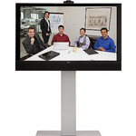

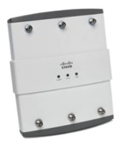
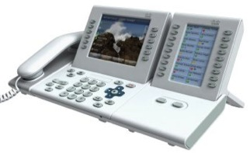
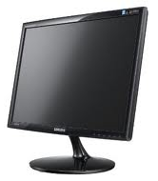

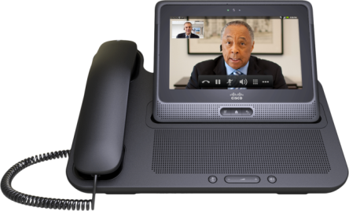

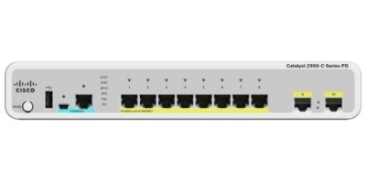
Escalabilidad y Flexibilidad en el uso de PoE
Endpoint power requirements are increasing
  Need for Granular power negotiation ‘and’ increased power
Green initiatives
APs, IP Phones, Thin clients…
Desktop Virtualization, IP Phone Video, Displays, Netbooks, IoT…
Telepresence, PCs, Servers…
0 W
30 W
60 W
90 W
Universal PoE

Slide 7
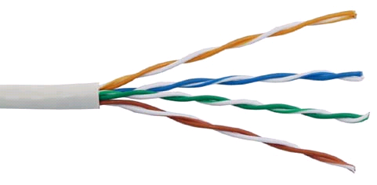
Cisco Universal PoE
UPoE
C4500, C3850, C3750-X/3560-X,
30W
Cat5e
Universal Nature
Standard RJ45 Connector
No Cabling Change from PoE+
High Availability
Uptime for critical apps (e112)
Low TCO with UPS consolidation
Green
10% more efficient than bricks
Management with EnergyWise
IEEE 802.3at (PoE+)
Maximum power sourced = 30W
30W
Cat5e
60W
30W
UPOE
Maximum power sourced = 60W
Supported by all cabling standards
Compatible with PoE and PoE+

Slide 8
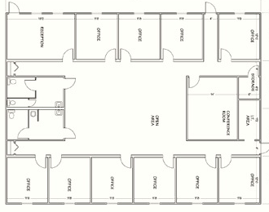
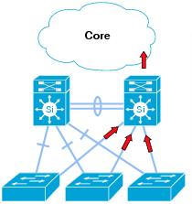



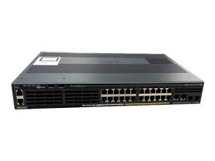
Techos Digitales: Light as a Service (LaaS)
Example of Deployment Model
UPS Powered Critical Infrastructure
Essential Lighting
[Centralized]
[Distributed]
Mains
CAT cables with PoE
Uplink CAT cables
2960-CX/3560-CX
2960-X Cool SKU
Notes:
This is one of the deployment models..
Central – home run to wiring closet..
Distributed - this one..
Hybrid – combination of both..
8 ports of PoE (first eight ports only) with ability to deliver a sum total of 110W of PoE power. This switch has four Gigabit Ethernet uplinks: two of them SFP and the other two 10M/100M/1000M copper interfaces

Slide 9
Innovación & Evolución: Rendimiento y Escalabilidad

Slide 10


En 2012 WiFi rompió la barrera de 1G con 802.11ac
802.11ac Wave 1
Up to 1.3 Gbps
Opportunity
Speeds of 6.8G & beyond
Challenges
Existing Cat 5e cables limited
to 1G
PoE for Multigigabit
Investment Protection
802.11ac Wave 2
Up to 6.8 Gbps
Now, WiFi at LAN Speed

Slide 11




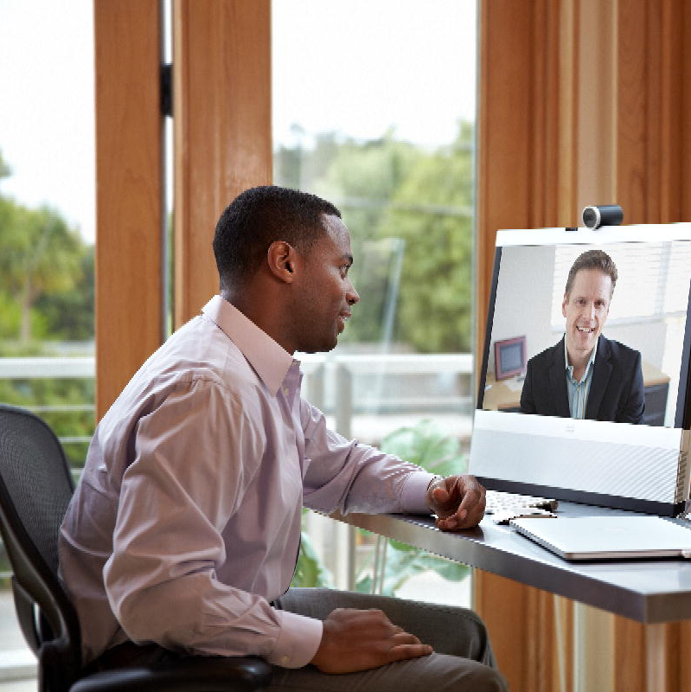


The Solution – Cisco Multigigabit
Technology Powered by NBASE-T
WiFi > 1G
Cat 5e Cables
2.5-5G!
Multigigabit
Switch
Multigigabit
Capable AP
Cisco Multigigabit with
Is a game-changing innovation allowing enterprise networks to evolve beyond 1G
Enables 2.5 and 5 Gbps up to 100m on legacy cables
Supports all PoE standards
up to 60W
Delivers up to 5X Speeds in Campus Networks without replacing Cabling Infrastructure

Slide 12
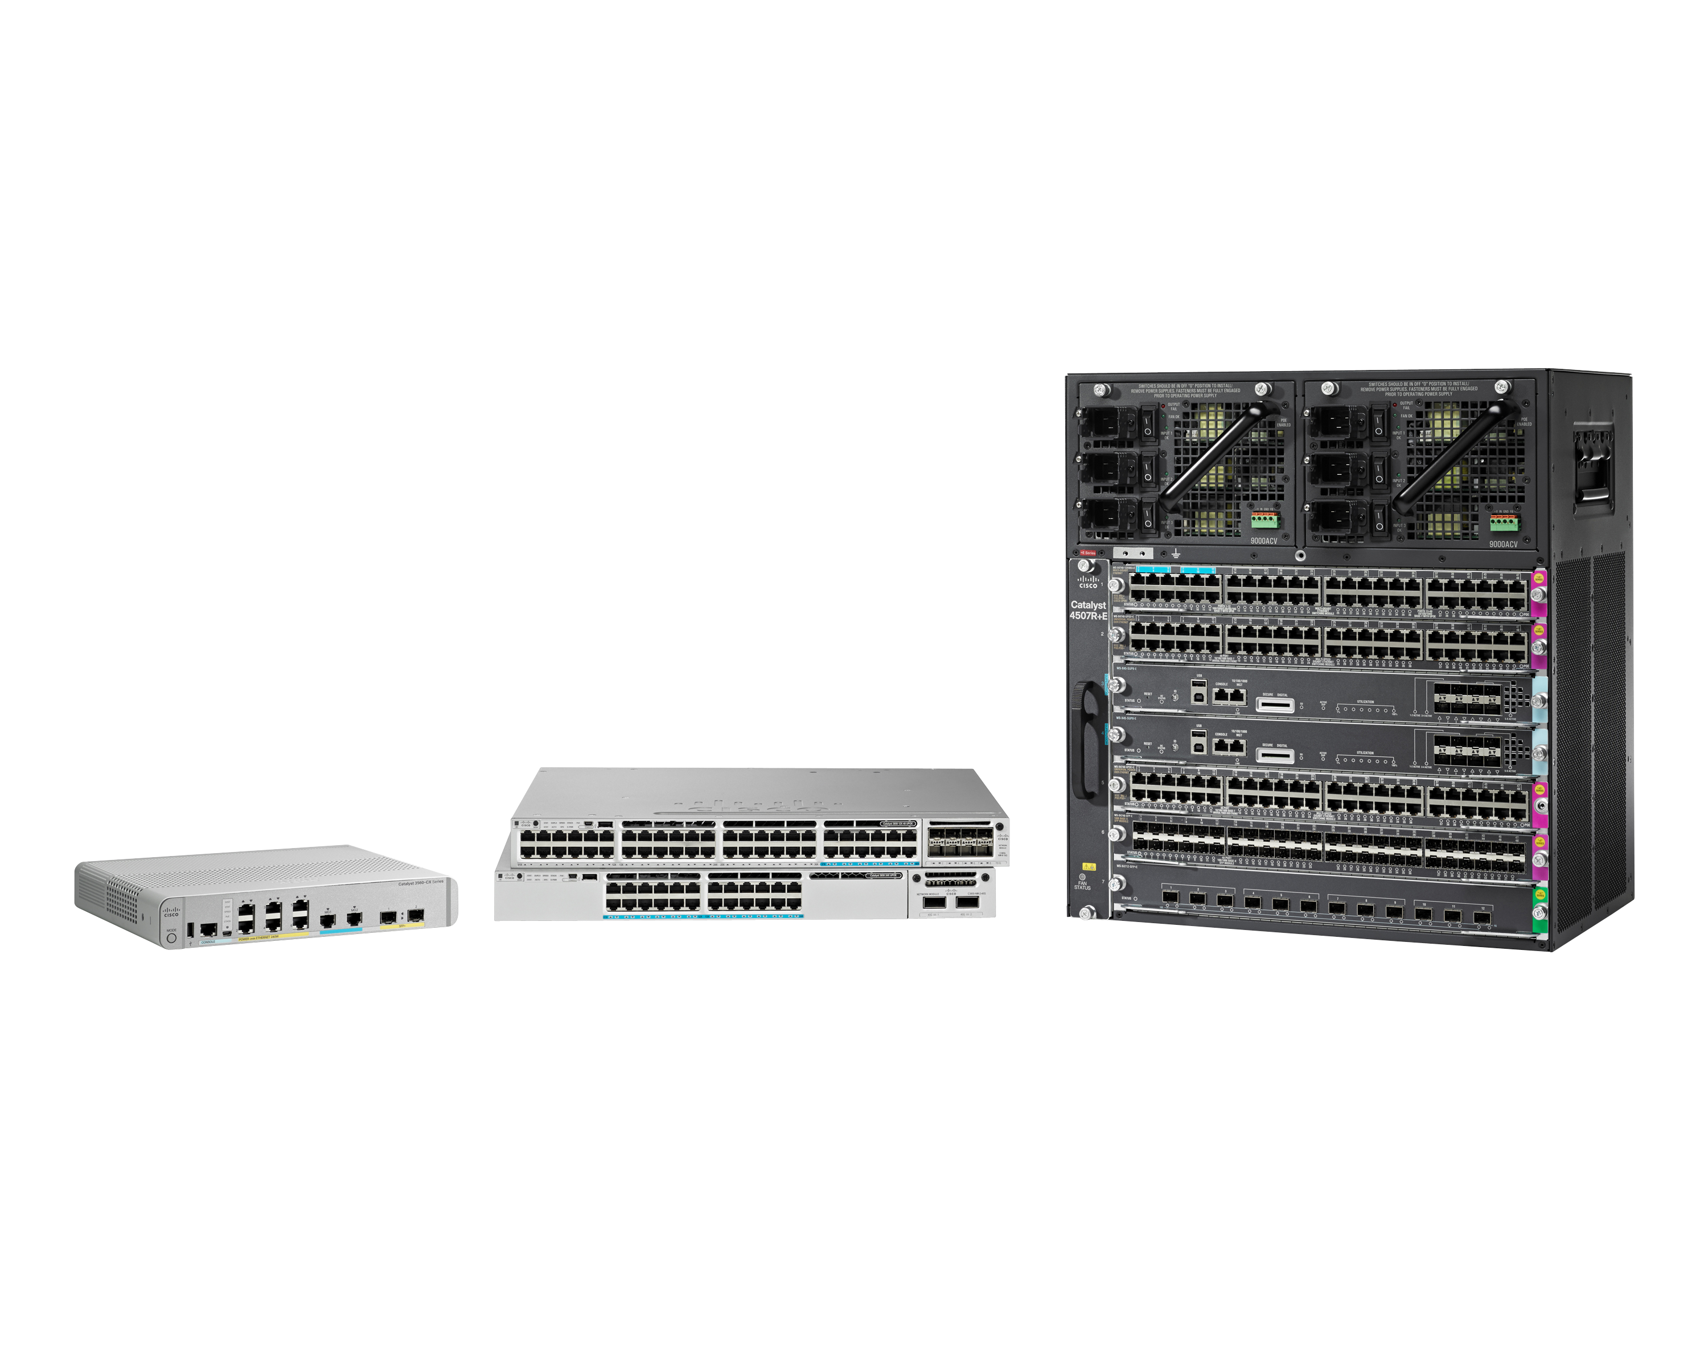
The NEW Cisco Catalyst Multigigabit Product Family
Get your network ready for 802.11ac Wave 2 explosion!!

Slide 13
Innovación & Evolución: Protección y Seguridad

Slide 14

Dynamic Threat Landscape
Network Threats Are Difficult and Expensive to Find
60%
85%
54%
51%
of data is
stolen in
HOURS
of point-of-sale intrusions
aren’t discovered for
WEEKS
of breaches remain
undiscovered for
MONTHS
increase of companies
reporting a $10M loss
or more in the last 3
YEARS
START
HOURS
WEEKS
MONTHS
YEARS

Slide 15
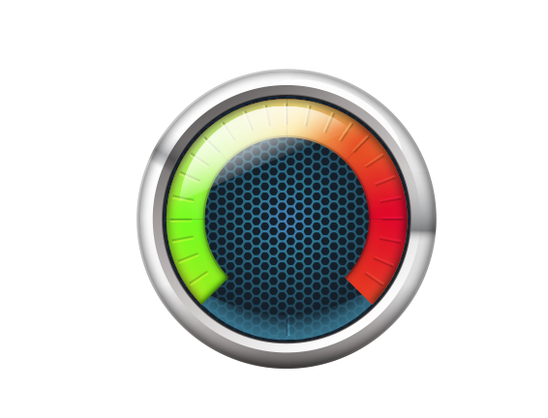



Network as a Security Sensor and Enforcer
Policy-Based Security at Scale
Simplify Security Policy, Automate Configuration & Change Management
Network as Security Sensor
Visibility at Scale to Monitor Activity,
Discover Threats, Ensure Compliance
(Using Flexible NetFlow)
Network as Security Enforcer
Consistent Access and Segmentation Policy Across the Network
(Using TrustSec)

Slide 16




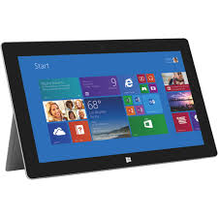







Network as a Sensor
Lancope StealthWatch and ISE Bring Security Analytics
NETWORK / USER
CONTEXT
Lancope
Visibility
Cisco ISE
Network Infrastructure
Who
What
Profiler Feed Service
Voice
Suppliers
Guest
Profiling Attribute Sources
When
Where
How
Data
Automatic updates
New device support
HTTP
DHCP/DNS
NMAP
NetFlow
RADIUS
SNMP
174.45.21.12
192.168.10.123
10.237.22.232
192.168.254.187
Employee 1
Finance Department
Personal iPAD 2
San Jose Branch
Contractor 2
LOB X
Android
Richardson, Floor 3
Partner A
LOB Y
Managed MAC Air
New York
Guest
Windows Tablet
RTP Lobby 1st Floor

Slide 17

Network as an Enforcer
Working with network to restrict access
Lancope
Visibility
Cisco ISE
Network Infrastructure
Voice
Data
Suppliers
Guest
Quarantine
Employee 1
Finance Department
Personal iPAD 2
San Jose Branch
Contractor 2
LOB X
Android
Richardson, Floor 3
Partner A
LOB Y
MAC Air
New York
Guest
Windows Tablet
RTP Lobby 1st Floor

Slide 18
Resumen

Slide 19
Innovación para la evolución de las redes de Campus
UPoE:
  Permite nuevos dispositivos y soluciones.
  Ahorro en costes, energía e incremento de la alta disponibilidad
Multigigabit te permite:
  Habilitar conexiones >1 Gbs compatibles con los estándares.
  Proteger la Inversión en infraestructura.
La Red de Campus te puede proteger:
  NaaS: Descubrir, Detectar e Investigar ataques.
  NaaE: Segmentar, Mitigar y Simplificar políticas de seguridad.

